Slide 1
Unit II Electro Analytical Techniques Topic: Introduction
Dr. P. G. Umape
Pune Institute of Computer Technology

Slide 2
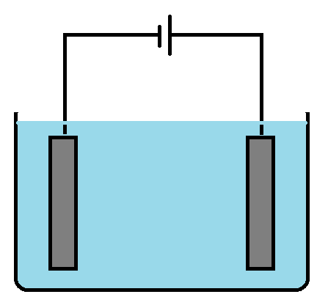
Introduction
What are the electroanalytical techniques?
These are the methods of analysis, where analyte sample is analysed by measuring conductance or potential offered by the sample
By using electrochemical cell.
Electrochemical cell:
It is composed of two electrodes
Anode and Cathode.
These electrodes are in contact
with electrolytic solution
Here at anode oxidation
occurs while at cathode reduction
-
+
+
-
+
-
-
+
+
-
-
-
+
+
Cathode
Anode

Slide 3
Introduction
The cell can be represented as
Anode ion ion Cathode
For example: Danial cell
At anode
Zn Zn⁺⁺ + 2 e⁻
At cathode
Cu⁺⁺ + 2 e⁻ Cu
Zn + Cu⁺⁺ Zn⁺⁺ + Cu
Net cell reaction

Slide 4
Introduction
EMF of a cell
E_{cell} = E_{cathode} – E_{anode}
Nernst equation:
It is an equation which relates the reduction potential of an electrochemical cell (half or full cell rection) to standard electrode potential, temperature and activities of the chemical species undergoing reduction and oxidation

Slide 5
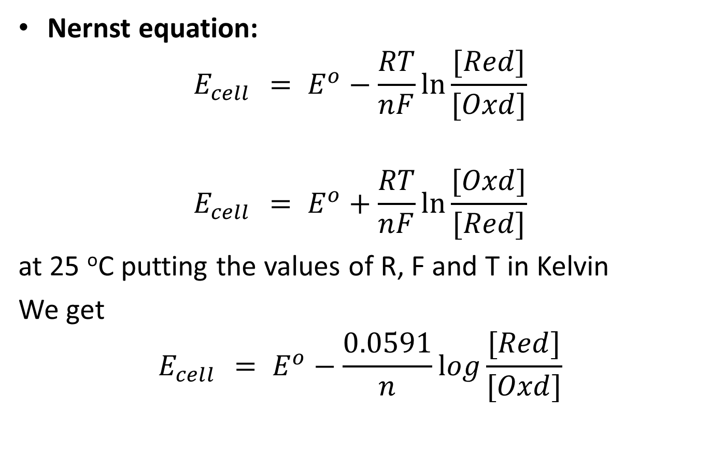
Introduction
Nernst equation:
$$E_{cell }= E^{o}−\frac{RT}{nF}ln\frac{[Red]}{[Oxd]}$$
$$E_{cell }= E^{o}+\frac{RT}{nF}ln\frac{[Oxd]}{[Red]}$$
at 25 ºC putting the values of R, F and T in Kelvin
We get
$$E_{cell }= E^{o}−\frac{0.0591}{n}log\frac{[Red]}{[Oxd]}$$

Slide 6
Introduction
Types of electrode:
Reference electrode and Indicator electrode
Reference electrode:
The electrode which produces stable and reproducible electrode potential irrespective of the nature and concentration of the electrolytic solution in which it is immersed.
It is coupled with the other electrode to complete a cell, it produces a stable and reproducible potential against which indicator electrode is compared and measured e.g. Calomel electrode, SHE, Silver-Silver chloride electrode.

Slide 7
Introduction
Types of electrode:
Reference electrode and Indicator electrode
Indicator electrode:
The electrode of which electrode potential changes with nature and concentration of electrolytic solution in which it is immersed.
Here Indicator electrode is coupled with reference electrode and this electrochemical cell is used for analysis of analyte.
Potential developed with the indicator electrode is a measured in electroanalytical analysis.

Slide 8

Calomel Electrode
Pt wire
KCl solution
To salt bridge
Hg+Hg₂Cl₂ paste
Mercury

Slide 9
Calomel Electrode
Construction:
It consist of a glass tube with tapering end.
Bottom of the end is porous
This bottom is filled with liquid mercury
There is a layer of paste of mercury and mercurous chloride over the liquid mercury
Then, the tube is filled with potassium chloride solution.
In order to have electric contact a platinum wire is immersed in liquid mercury at the bottom.
The electrode is connected with the help of the side tube on the left through a salt bridge with the other electrode to make a complete cell.

Slide 10
Calomel Electrode
Working:
Calomel electrode can be represented as.
Pt, Hg Hg₂Cl₂, Cl⁻
Cell reaction:
Anode: 2Hg + 2 Cl⁻ Hg₂Cl₂+ 2 e⁻
Cathode: Hg₂Cl₂+ 2 e⁻ 2Hg + 2 Cl⁻
Concentration of KCl | 0.1 N | 1 N | Saturated
Reduction Potential | 0.3334 | 0.281 | 0.2422

Slide 11
Thank You

